Slide 1
P-Card Essentials
Financial Training & Communications
INDIANA UNIVERSITY

Slide 2
Module 1: Technical Setup and Welcome

Slide 3
Course introduction

Slide 4
Goals of this training
Equip you with the knowledge you need to be a responsible cardholder.
Show you where to go for support when questions come up.
Audience for this course: future responsible P-Cardholders

Slide 5
Course structure
This course is made up of modules.
Each module consists of short videos followed by a quiz.
The course ends with a final assessment.
Responsible cardholders must earn a score of 80% or higher fulfill the training requirement and be granted a P-Card.

Slide 6
Completing the course
Complete this training at your own pace.
Take breaks as often as you like!
Canvas saves your progress, and you can pick up where you left off.
Select Modules in the left menu and scroll down the page until you find a page without a checkmark.

Slide 7
Download presentation slides
Slides are available at https://go.iu.edu/handouts.
Download the slides so you can click links – they are not clickable in video recordings – and take notes.
On the handouts page, scroll down to the P-Card section.
Click the .PPT link for the P-Card Essentials course.
Download the slides.

Slide 8
Module 2: P-Card Background

Slide 9
Key concepts

Slide 10
P-Card program platforms
External financial institution that issues P-Cards.
Offers an online portal used to access card statements, credit limits, and more.
IU’s expense reconciliation system.
Completed US Bank transactions are fed into the eWallet for review and reconciliation.

Slide 11
Roles in P-Card programs
Purchase Requestor
Person who needs to use the card to buy something
Responsible for turning in receipts and explaining the purchase
Responsible Cardholder
Transactions appear in their Emburse eWallet
Ensure P-Card use complies with policy and procedure
Reconciler
Reconciles credit card transactions in the eWallet
Resolves non-compliant or incorrect transactions
Transaction Approver
Fiscal Officer (FO) or a delegate they have assigned
Ensure transactions comply with policy

Slide 12
Multiple roles
You may have more than one role in your P-Card program
Responsible Cardholder
Reconciler

Slide 13
Multiple roles
You may have more than one role in your P-Card program
Responsible Cardholder
Transaction Approver

Slide 14
Multiple roles
You may have more than one role in your P-Card program
Responsible Cardholder
Reconciler
Transaction Approver

Slide 15
P-Card policies
FIN-PURCH-07:
Procurement Card Program
FIN-ACC-620:
The Accountable Plan
Owned by Card Services
Defines roles and responsibilities required to have a compliant P-Card program.
Owned by the Office of the University Controller (UCO)
Defines the criteria a P-Card expense must meet, reconciliation timelines, and tax implications
Card Services maintains a plethora of SOPs!

Slide 16
Local requirements
Your campus, organization, or department may have internal guidelines in addition to the university standard.
Card Services does not track or have knowledge of local procedures.
Always check with your local office to ensure you’re following their procedures!

Slide 17
Guiding principles
Stewardship of university resources
National Association of Education Procurement (NAEP)
Internal Revenue Service (IRS) Accountable Plan

Slide 18
Stewardship
The practice of ensuring IU resources are used in support of IU’s mission.
It takes everyone, not just fiscal staff, to ensure business is conducted compliantly.
Anyone who does business on behalf of the university is a steward of IU funds.

Slide 19
National Association of Education Procurement
IU is a member of NAEP.
Provides guidance for ethical procurement in the higher education field through their Code of Ethics.
IU policies are written with these standards in mind.

Slide 20
IRS Accountable Plan
IU’s Accountable Plan policy describes how IU will comply with tax regulations determined by the IRS.
The IRS defines:
Characteristics of a business expense
How expenses must be substantiated
Substantiation timeframe to avoid being taxed

Slide 21
Guiding principles
Stewardship of university resources
National Association of Education Procurement (NAEP)
Internal Revenue Service (IRS) Accountable Plan
When you follow IU policy, you comply with the external requirements IU business must meet.

Slide 22
Purchasing hierarchy

Slide 23
Spending IU dollars with intention
BUY.IU
P-Card
Personal funds
Can IU funds be used for this purchase?

Slide 24
Business expenses are…
Necessary
Appropriate
Reasonable
Legitimate
to the activity at hand
to conduct IU business
in amount
support of IU’s mission

Slide 25
Substantiation documentation
For P-Card purchases, substantiation must include a merchant-provided receipt or invoice.
Can also include:
Email communications
Program descriptions
Anything that explains the business connection
The purchase requestor is responsible for proving the business connection and providing the necessary substantiation documentation to the reconciler.

Slide 26
Ask yourself:
Would an independent person, such as an auditor, also conclude that the purchase was necessary, appropriate, reasonable, and legitimately business-related given the substantiation documentation provided?
Is the answer “no” or “maybe?”
Collect and submit additional substantiation documentation.
If you can’t clearly show a business connection,
the purchase should not be made with IU funds.

Slide 27
Purchasing hierarchy
First choice: BUY.IU
Commonly purchased items such as office or lab supplies
Purchases involving a contract
Second choice: P-Card
Not available in BUY.IU
Merchant only accepts credit cards
Last resort: Personal funds
Review SOP-PURCH-38: Ways to Make a Purchase to learn more

Slide 28
Out-of-pocket reimbursement
Not a preferred procurement method.
Should be avoided whenever possible.
When making a business purchase, BUY.IU or a P-Card is always preferred.
Review out-of-pocket reimbursement materials to learn more.

Slide 29
Card spending limits

Slide 30
University spending limits
Single Transaction
Billing Cycle
$4,999.00
Transactions over this limit are automatically declined.
Lower thresholds are not enforced by US Bank.
$20,000.00
One P-Card allows up to $20,000 worth of transactions per billing cycle.
Responsible cardholder can check the card balance using their US Bank portal.
Your campus, organization, or department may have lower thresholds to consider.

Slide 31
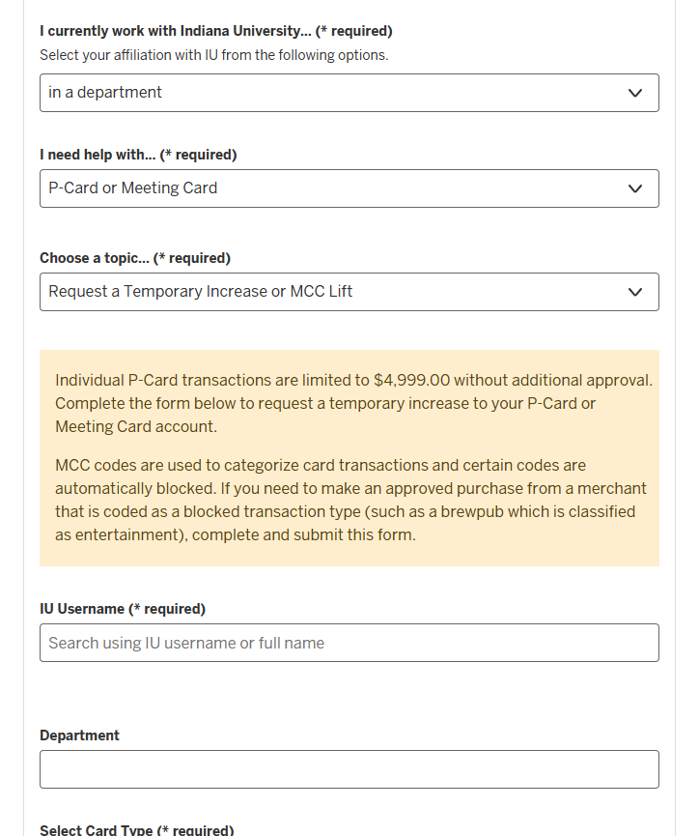
Request an increase
Card Services can temporarily increase a P-Card spending limit.
Requested by a Fiscal Officer.
Submit a Support Form to request.
P-Card or Meeting Card
Request a Temporary Increase or MCC Lift

Slide 32
A final note
Cost isn’t the only consideration when using the P-Card; also think about what is being purchased.
Restricted items should never be purchased with the P-Card or require special approval.
Just because a purchase is less than $4,999.00 does not mean it is allowable to purchase with the P-Card.

Slide 33
Sales tax

Slide 34
IU’s tax status
The IRS classifies Indiana University as a government entity.
A purchase is a business expense if it meets the criteria defined in policy FIN-ACC-620.
Necessary
Appropriate
Reasonable in amount
Served a legitimate university purpose

Slide 35
P-Card and sales tax
P-Card purchases are not automatically tax free!
Tax exempt documentation must be submitted to the merchant.
Indiana-based merchants use IU’s Indiana sales tax exemption number.
Sales Tax Exempt #0003123294

Slide 36
Sales tax outside Indiana
IU is registered as an employer in many states across the U.S.
The university has established tax-exempt status with these states.
Visit the Office of the University Controller (UCO) website to locate out of state tax exemption forms.

Slide 37
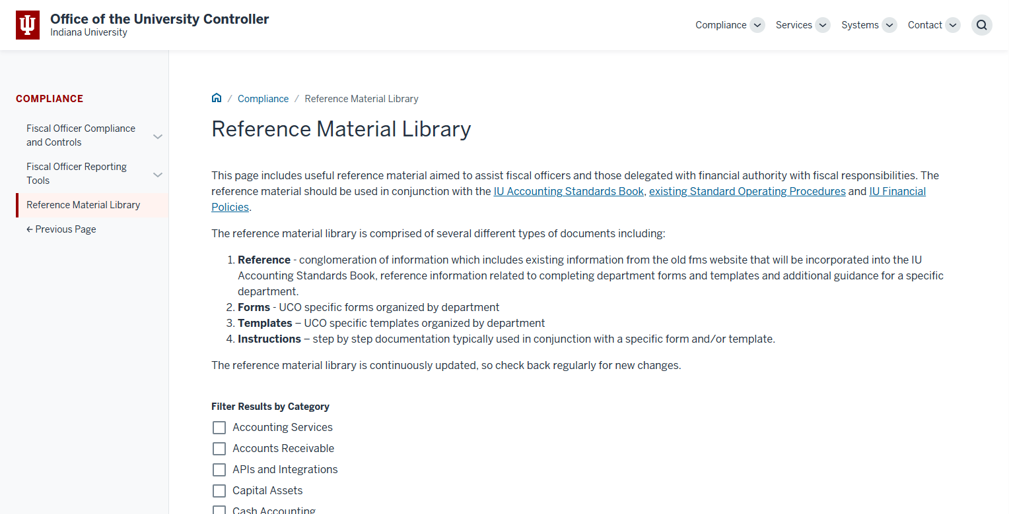
In the Reference Material Library, scroll down.

Slide 38
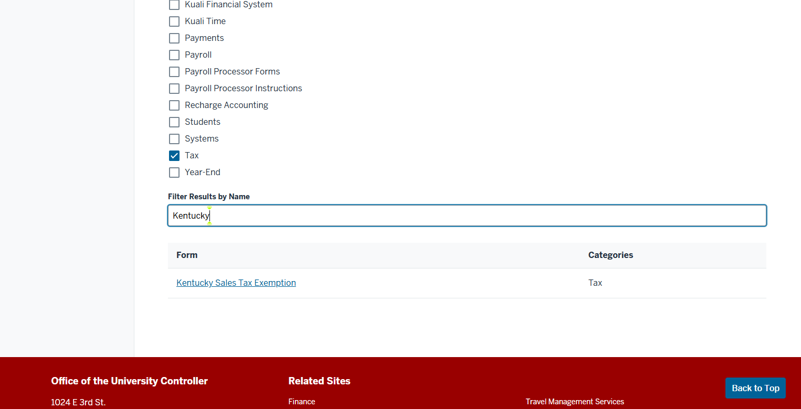
Check the box next to Tax and enter the name of the state you’re looking for.
Click on the name of the Form to download it.

Slide 39
Paying sales tax
Request specialized state tax exemption forms through the UCO’s Contact Form.
Merchants may choose not to honor IU’s tax-exempt status.
Check out the So, you were charged sales tax video to learn how to handle this situation.

Slide 40
Types of P-Cards

Slide 41
Types of P-Cards
Individual cards
Department cards
The person issued the card is the only person who uses the card.
Person’s name is printed on the face of the card and card is signed by them.
Intended to be used by multiple individuals within a department.
A department or group name is printed on the face of the card and the card should not be signed.

Slide 42
Individual responsible cardholders
Responsible cardholder should be the same person named on the face of the card.
This person is responsible for ensuring all their purchases comply with IU policy and procedure.
If another individual reconciles expenses, cardholder is responsible for submitting receipts and other documentation in a timely manner.

Slide 43
Department responsible cardholders
Multiple people use the card, but only one individual can be named the responsible cardholder.
Department defines the responsible cardholder.
This person is responsible for:
Tracking the purchase requestor
Ensuring compliance with IU policy and procedure
Verifying receipts and other documentation are submitted to the reconciler.

Slide 44
Choosing a card type
IU departments are responsible for choosing the appropriate P-Card type for their business processes.
Only one physical card will be issued per P-Card account.

Slide 45
Module 3: Using the P-Card

Slide 46
Card sign-out process

Slide 47
Tracking department card use
The responsible cardholder must track who is using the card, when, and why.
The P-Card sign-out log should be completed every time use of the P-Card is requested.

Slide 48
P-Card sign-out process
If you create your own sign-out log, it must collect these four key pieces of information at a minimum:
The IU username of the purchase requestor.
The purchase date.
The merchant name.
The dollar amount.
Use the P-Card Sign-Out Template provided by Card Services.

Slide 49
Saving records
If your department has more than one P-Card, maintain a separate sign-out log for each card.
Save sign-out logs for three fiscal years.

Slide 50
Collecting receipts
Make sure purchase requestors know they must turn in a receipt.
Submit a paper receipt.
Forward an emailed invoice.
Upload a scanned image to a shared drive.
The important thing is that receipts are turned in as soon as possible.

Slide 51
Purchasing restricted items

Slide 52
Restricted items
Have additional compliance considerations.
How do I know if the purchase I’m making is restricted?
Check SOP-CARD-04: Restricted Items
Bonus! SOP lists how restricted items should be purchased, or the situation should be handled.

Slide 53
Examples of restricted items
Furniture and décor
Professional services
Recurring payments
Gift cards
Online auction sources
Contracted items

Slide 54
Contracted items
A contracted item is something that can be purchased from a catalog supplier in BUY.IU.
Always check BUY.IU first when making a purchase.
If a catalog supplier sells what you need, make the purchase in BUY.IU.

Slide 55
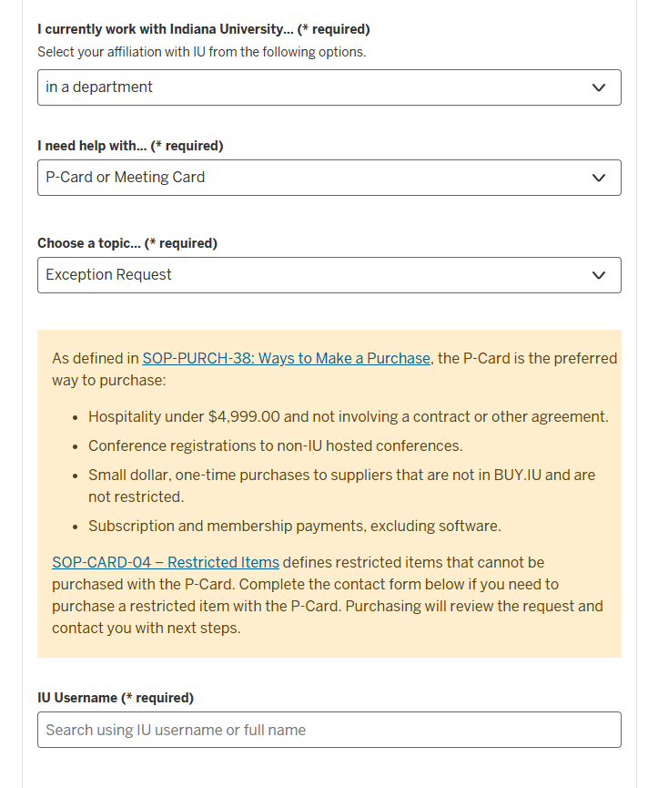
Request an exception
What if a restricted item is available from a merchant that only accepts payment via credit card?
Submit a Support Form using options:
P-Card or Meeting Card
Exception Request
Save Purchasing’s approval and submit it with your receipt to the reconciler.

Slide 56
If your purchase is…
Greater than $4,999.00, or
One of these types of items:
Entertainment
Transportation
Vehicle rental
Insurance
Head back to the Support Form and submit another request using:
P-Card or Meeting Card
Temporary Increase or MCC Lift
Card Services will update the P-Card account so the transaction can be processed.
Reference Purchasing’s exception approval in the Description field.

Slide 57
Hospitality

Slide 58
What is hospitality?
Meals, refreshments, or related supplies purchased in support of IU’s mission.
Team lunch
Beverages for a student event
Dinner with a job candidate, etc.
Hospitality purchases promote or further IU’s mission.

Slide 59
Hospitality procedures
Hospitality purchases are governed by policy FIN-ACC-50: Hospitality Expenditures.
Use the P-Card for hospitality when:
The expense is less than $4,999.00 and
The purchase does not involve a contract.
Always consult your business office and follow local compliance considerations.

Slide 60
Why is the P-Card preferred?
Hospitality orders often need to be adjusted, sometimes at the last minute.
BUY.IU | P-Card
Merchant submits invoice for final version of order. Invoice differs from purchase order. Additional review required. | Merchant charges P-Card for final version of order. Credit card charge in the eWallet matches the receipt.

Slide 61
Alcohol
Alcohol may be purchased using IU funds if the purchase meets the criteria defined in policies:
FIN-ACC-50: Hospitality Expenditures, and
FIN-INS-10: Service of Alcohol
Offsetting alcohol purchases with IU Foundation funds is not required.

Slide 62
Blocked transactions
Establishments that sell food and alcohol, such as…
brewpubs, breweries, or wineries
…may be categorized as entertainment and automatically blocked by US Bank.
Submit a Support Form so Card Services can update the P-Card account. Use form options:
P-Card or Meeting Card
Temporary Increase or MCC Lift
Card Services will update the P-Card account to help ensure the transaction goes through.

Slide 63
Event refreshments
If beverages are offered at your event:
Coca-Cola products must be served.
Events held on IU property, sponsored by IU, or associated with IU.
This requirement applies to water, juice, any type of beverage.

Slide 64
In-store purchases
When shopping at Kroger or Target, use IU’s rewards account number by entering the phone number:
(812) 855-2223
You cannot use a personal rewards account when paying with IU funds.
Some merchants apply IU’s sales tax exemption along with the rewards account.
Visit the IU Rewards page

Slide 65
Sam’s Club and Costco
IU does not have a university-wide membership with these wholesalers.
These stores do not honor IU’s sales tax exemption.
P-Cards can be used in conjunction with certain types of personal memberships for certain types of purchases.

Slide 66
Wholesale purchases
Allowable
Unallowable
Using the P-Card with an employee’s basic membership.
Purchasing food items, like packaged snacks and bottled water, only.
Using the P-Card with an employee’s membership that earns cashback, points, or any other type of reward.
Purchasing non-food items like paper plates, utensils, etc.

Slide 67
Check your receipt!
Before leaving the store or restaurant, check the receipt and verify that sales tax wasn’t charged.
If sales tax was charged:
Locate an employee.
Point out the sales tax exemption number on the face of the P-Card.
Request an updated receipt without sales tax.
If the merchant requires a full ST-105 sales tax exemption form, return later with the form and request a credit for the sales tax.

Slide 68
Software purchases

Slide 69
What is software?
A program installed on a machine or a cloud-based service that’s accessed online.
Knowledge Base: About Software at IU
Software is a restricted item and should not be purchased with a P-Card.
What do you do if the merchant only accepts payment by credit card?

Slide 70
Software and Services Selection Process (SSSP)
University Information Technology Services (UITS)
Reviews software requests from a technical perspective.
Purchasing
Determines if software must be purchased through BUY.IU or if the P-Card can be used.
Person needs to buy software
SSSP request submitted.
Review the SSSP Knowledge Base article.

Slide 71
P-Card approval
Save Purchasing’s approval and submit it along with your receipt from the purchase.
Submit a Support Form so the Card Services team can update the P-Card account.
On the form, select:
P-Card or Meeting Card
Temporary Increase or MCC Lift
Include your SSSP number and a note that Purchasing approved the use of the P-Card.
Reminder:
Software is a restricted item!

Slide 72
Software renewals
The initial SSSP approval or approval to use the P-Card to purchase the software do not apply to software renewals.
Submit a new SSSP request.
Purchasing will determine if the P-Card can be used.
Save Purchasing’s approval and submit it with your receipt to the reconciler.

Slide 73
Amazon Business

Slide 74
Amazon Business
A great option, but not the first place you should look when making a purchase.
Tax exempt purchases. IU’s sales tax exemptions are automatically applied.
Customer Service. Exclusive access to a special support team.

Slide 75
Create an account
Must create an Amazon Business account within IU’s organization account.
Submit a Support Form:
P-Card or Meeting Card
IU Amazon Business Account
You must request an account from Card Services.
To shop, visit
business.amazon.com

Slide 76
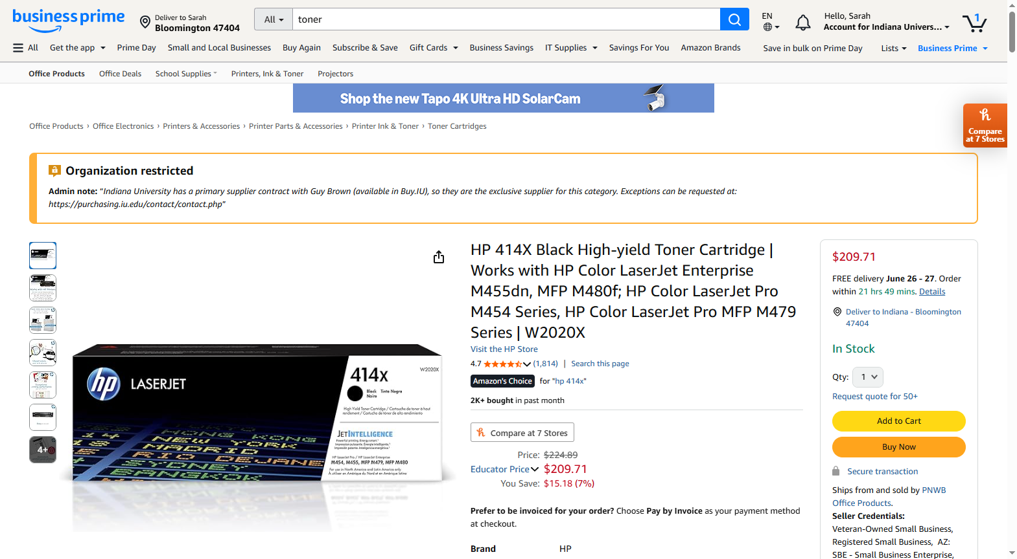
Should not be purchased from Amazon without prior approval from Purchasing.

Slide 77
Amazon vs BUY.IU
What if you find an item that’s available in BUY.IU but Amazon offers it for a lower price?
If an item is available in BUY.IU, it must be purchased through BUY.IU unless you have special approval from Purchasing to buy it elsewhere.

Slide 78
Requesting exception approval
Submit a Support Form using the following options:
P-Card or Meeting Card
Exception Request
Describe the item and why you need to purchase it from Amazon instead of BUY.IU.

Slide 79
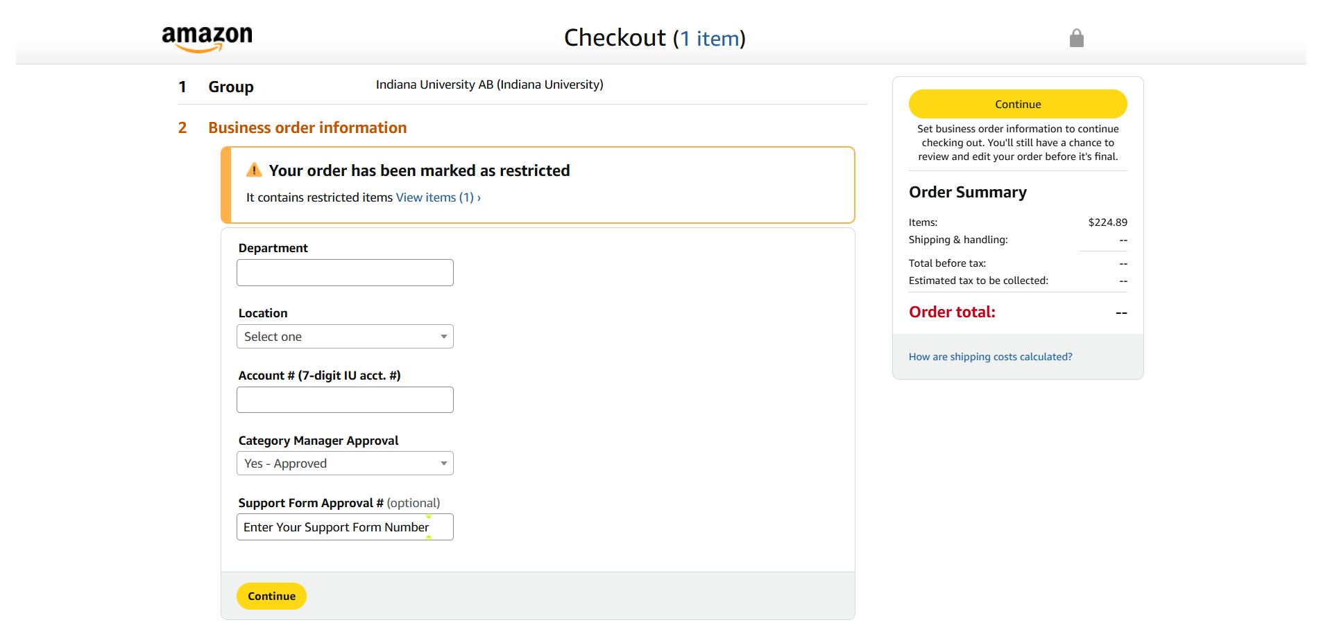
Submit a copy of Purchasing’s approval with your receipt so it can be attached to the P-Card expense.

Slide 80
Flowers

Slide 81
Allowability
IU funds cannot be used to purchase flowers for life events such as a wedding or birth of a child.
Flowers for these types of life events must be purchased with personal funds collected from staff.
Referred to as “pass the hat.”
Not reimbursable.

Slide 82
Funerals and bereavement
It is allowable to purchase sympathy flowers if the person who passed was:
Spouse | Grandparent
Child | In-law relative of the same degree
Grandchild | Step relative of the same degree
Parent | Other relative of whom the IU employee is the sole survivor
Sibling
The P-Card can be used but the expense MUST be reimbursed with IUF Funds.

Slide 83
Flowers as event décor
Locate a florist in BUY.IU, or establish one as a supplier, then create a purchase order.
If the florist does not accept purchase orders, use the P-Card to purchase the flowers for the event.

Slide 84
Declined transactions

Slide 85
Classifying P-Card transactions
Every credit card transaction is classified using a Merchant Category Code, or MCC.
MCCs are selected by the merchant, not US Bank or Card Services.
It isn’t possible to know how a transaction will be coded until the transaction is tried.
IU P-Card accounts are programmed to automatically decline MCCs related to goods and services listed in SOP-CARD-04: Restricted Items.

Slide 86
Request an MCC Lift
If Purchasing approves using the P-Card to purchase a restricted item, Card Services must update the P-Card account.
On the Support Form use these options:
P-Card or Meeting Card
Temporary Increase or MCC Lift
The Card Services team will temporarily update your P-Card account to allow the transaction.

Slide 87
Declined transactions
Transactions may be declined due to how the merchant is classified.
Notify Card Services via the Support Form using options:
P-Card or Meeting Card
Declined Transactions
Be prepared to describe the details of the purchase.
Card Services will adjust your account so you can try the transaction again, if appropriate.

Slide 88
Help! I’m at the register
If your card is declined at the merchant and you need immediate assistance:
Staff are available during regular business hours.
Contact Card Services by phone: (812) 856-3790

Slide 89
Module 4: Reconcile & Support Purchases

Slide 90
Reconciliation timing requirements: responsible cardholder edition

Slide 91
What is reconciliation?
The process of:
Reviewing a transaction for accuracy.
Substantiating it with appropriate receipts.
Assigning it an object code and department account number.

Slide 92
Who makes the rules?
Internal Revenue Service
Indiana University
To avoid being considered taxable income, the IRS requires that prepaid business expenses, like P-Card purchases, be:
Reconciled within a defined timeframe
Substantiated with an original receipt
IU’s Accountable Plan policy defines the timeframe P-Card expenses must be reconciled within.
Per policy FIN-ACC-620, P-Card purchases must be reconciled within 60 days of the date of purchase.

Slide 93
Your responsibility
As the responsible cardholder you must:
Ensure proper usage of the P-Card
AND
Ensure the reconciler has the information they need to meet these Accountable Plan guidelines.

Slide 94
Missing the reconciliation deadline
If more than 60 days have passed since the purchase date, the charge must still be reconciled.
Charges where 61+ days have passed since the purchase date are referred to as “aged transactions.”
The purchase requestor will be taxed on the value of the aged P-Card transactions.
Extra taxes will be deducted from their payroll payment…
Ultimately, this results in less net pay for the purchase requestor.

Slide 95
Card suspension
P-Card accounts that regularly fail to meet Accountable Plan requirements may be suspended or confiscated by your Fiscal Officer.

Slide 96
Compliance tips
Closely track P-Card usage. Use a sign-out sheet for department P-Cards.
01
Purchase requestors turn in their receipts after using the card.
02
Reconciler has everything they need to complete a monthly P-Card reconciliation.
03

Slide 97
Additional training
Are you the responsible cardholder and reconciler?
Complete the P-Card Reconciliation course in Canvas.

Slide 98
The purchase requestor

Slide 99
Who is the purchase requestor?
The person who initiates the use of the P-Card because they need to buy something.
Responsible for turning in receipts that substantiate their purchase and explaining why it was a valid use of IU funds.

Slide 100
Reconciliation and tax impact
The purchase requestor takes on the tax impact of a P-Card purchase if it is not reconciled within 60 days of the purchase.
Only one person can be named as the purchase requestor.
The responsible cardholder must track this information and make it available to the reconciler.

Slide 101
Determine the purchase requestor
First step: Determine what type of P-Card was used:
An individual card
A department card

Slide 102
Purchase requestor by card type
Individual card
Department card
Individual cards have a person’s name printed on the front of the card.
Should only be used by that person.
Group or department name printed on the front of the card.
Intended to be used by multiple individuals.
The purchase requestor is the person who initiated the use of IU funds.
Not necessarily the person who used the card.
The purchase requestor is always the person named on the card.

Slide 103
Purchase requestor scenario
Professor Farnsworth contacts his assistant, Amy, and asks her to order a book from Amazon Business to aid his research.
Amy places the order on Amazon using the department P-Card.
In this scenario, who is the purchase requestor?
The professor or Amy?

Slide 104
Purchase requestor
Professor Farnsworth
Amy
Requested the purchase.
Will be taxed if transaction is not reconciled within 60 days of purchase.
Is responsible for ensuring receipt is turned in and explaining need for the purchase.
Placed the order on Amazon.
Used the P-Card.
Amy may help by turning in a receipt, etc., but the professor is the purchase requestor and is ultimately responsible.

Slide 105
Tracking
Tracking the purchase requestor is a key responsibility of department P-Cardholders.
Refer to the Card sign-out process video for more information and tips.

Slide 106
Documenting and supporting purchases

Slide 107
You may be wondering…
If the transaction is already in the eWallet, why do we need documentation?
The reconcilers uses information on receipts and other documentation to verify we were charged what we expected to be charged.

Slide 108
Expense discrepancies
Usually, documentation and eWallet items match.
Discrepancies may happen if sales tax is charged or the purchase requestor forgot to write down the tip charged on a meal.
Who resolves discrepancies?
The reconciler works with the purchase requestor, the merchant, or US Bank via Card Services.

Slide 109
Receipt requirements
Valid receipts contain:
Merchant name
Transaction date
Itemized list of what was purchased
Proof of funds tendered. The last four digits of the P-Card used.

Slide 110
Substantiation goals
A merchant-provided receipt or invoice is the minimum.
Validity of use of funds should be obvious to an independent person, like an approver or auditor.
The goal of substantiation documentation is to prove the validity of an expense as a use of IU funds.

Slide 111
Supplemental documentation
Hopefully, the information on a receipt tells the whole story.
Receipts and invoices can be supplemented with:
Emails
Program information
Anything that helps explain the reason for the purchase
Purchase requestors need to know where to submit their documentation.
Reconcilers need to know where to find it.

Slide 112
Incomplete or lost receipts: responsible cardholder edition

Slide 113
Receipt requirements
Valid receipts contain:
Merchant name
Transaction date
Itemized list of what was purchased
Proof of funds tendered. The last four digits of the P-Card used.
What should you do if the purchase requestor turns in a receipt that’s missing information or doesn’t turn in a receipt at all?

Slide 114
Incomplete receipts
Purchase requestors are responsible for substantiating and explaining their P-Card purchases.
Contact the purchase requestor and instruct them to contact the merchant and request a receipt that contains the missing information.
An incomplete receipt contains some of the required information but not all of it.

Slide 115
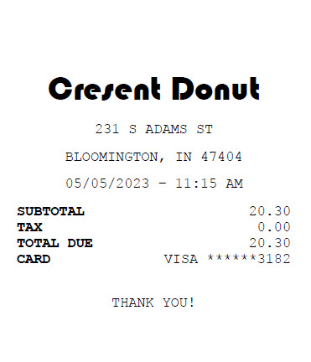
Incomplete receipt example
Merchant name?
Transaction date?
Proof P-Card was used?
Itemized list of purchase(s)?
The purchase requestor should contact the merchant, request a complete receipt, and submit it to the reconciler.

Slide 116
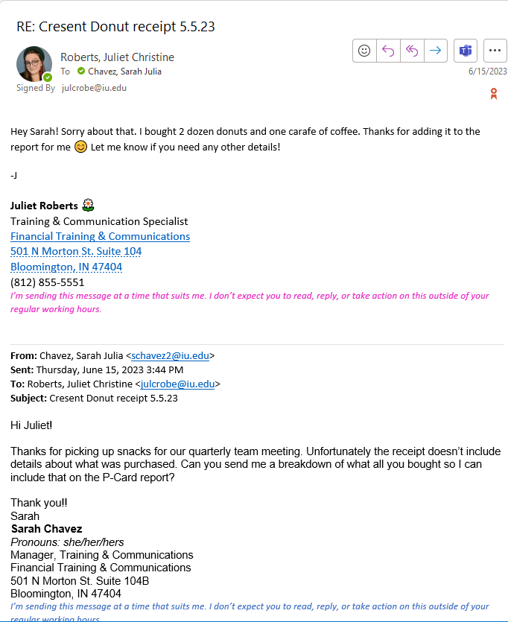
Supplemental documentation
Merchant can’t or won’t provide a complete receipt?
Purchase requestor should document the missing details and submit them to the reconciler.

Slide 117
Lost receipts
Instruct the purchase requestor to contact the merchant and request a receipt.
If they make multiple attempts and can’t get a receipt, ask the requestor to email the transaction details to the reconciler.
MISSING
One (1)
P-Card receipt.
P-Card charges can be reconciled without a receipt, but this is a last resort.

Slide 118
Local procedures
The steps described are Card Service’s requirements.
Your local business office may have specific forms that must be completed when a receipt is lost or missing information.

Slide 119
Module 5: Card Management

Slide 120
Card suspension: responsible cardholder edition

Slide 121
Card suspension procedure
Fiscal Officers may confiscate a P-Card or suspend a card if the account consistently fails to comply with IU’s Accountable Plan policy.
Noncompliance consists of:
Transactions not being reconciled within 60 days of the purchase date.
Transactions not being substantiated with appropriate documentation.

Slide 122
Card suspension length
The Fiscal Officer (FO) determines the length of the card suspension:
30, 60, or 90 days
Requested by the FO via the Support Form using these options:
P-Card or Meeting Card
Suspend a P-Card

Slide 123
Account closure
Card Services tracks how many times a card account has been suspended.
An account may be suspended up to three times.
If a fourth suspension is requested, the account will be closed.

Slide 124
Your responsibility
Ensure purchase requestors turn in complete receipts
Make sure the reconciler has the information they need to reconcile P-Card charges in a timely manner.
If you’re the responsible cardholder and the reconciler, complete the P-Card Reconciliation course.

Slide 125
Lost or stolen cards

Slide 126
Report lost or stolen cards immediately!
US Bank’s Fraud Prevention team is available 24 hours a day.
Domestic calls: 1 (800) 523-9078
International calls: 1 (701) 461-2010

Slide 127
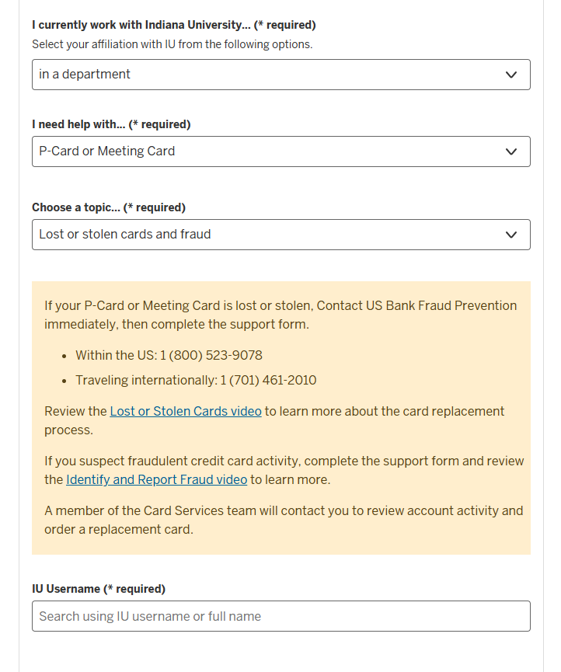
Notify Card Services
Submit a Support Form using options:
P-Card or Meeting Card.
Lost or stolen cards and fraud.
Be prepared to provide details about the last three valid transactions including the merchant names, amounts, and transaction dates.

Slide 128
Card Services…
Contacts US Bank and verifies the account is on hold.
Reviews card activity using details submitted on Support Form.
Requests a new card on your behalf.
Replacement cards are processed in 2-3 business days.

Slide 129
Cardholders should…
Monitor account activity for at least 30 days after a card is reported lost or stolen.
Review the Identify and Report Fraud video to learn how to report and dispute charges you don’t recognize.
If the lost or stolen card is eventually found, destroy the card immediately. It is no longer functional.

Slide 130
Secure that P-Card!

Slide 131
Card storage
A credit card number is classified as critical data at IU and requires the very highest level of protection.
When not in use, an IU credit card should be stored in a locked desk drawer.
Never store IU cards alongside your personal credit cards or add them to mobile wallets.

Slide 132
Card storage, continued
Card numbers should never be written down on a sticky note and saved in a desk drawer...
…or worse, left on a desk where the information is visible!
Do not take pictures of the card and save them for future use.
Department cards must be signed out each time they are used.

Slide 133
Saving card info online
Strongly discouraged.
IU’s credit card security is only as strong as the merchant’s security.
A database breach means IU’s data is exposed.
If this happens, contact Card Services via the Support Form and close the account.
Review the Lost or Stolen Cards video to learn more.
Exception: The P-Card can be saved to an IU Amazon Business profile.

Slide 134
Sharing card info
A purchase requestor is approved to use the P-Card but cannot physically access the card.
Instead:
Call the purchase requestor, or
Use SecureShare, IU’s secure file sharing platform.
NEVER email credit card details.

Slide 135
Ultimately:
Think about how you would store or share your personal credit card information.
If you wouldn’t do something with your personal credit card, don’t do it with an IU credit card!

